Slide 1
Traffic Violation Detection System
Presented By
Chitraleka.G.V
Boobalaragavan.P
Kowreesh.G
Santhiya.S
II Year MSc Software Systems, Department of Computing,Coimbatore Institute of Technology, Coimbatore,India.
1

Slide 2
Objectives
Automate traffic violation detection system
This system is very helpful to traffic police to monitor the traffic and to find the vehicles which are violating the traffic rules
Detecting the vehicles which are violating the traffic rules at signals such as crossing the white lanes and moving before the green signals etc..,
2

Slide 3
OVERVIEW
This system has two components:
Detecting the vehicle
Recognising the violation
3

Slide 4
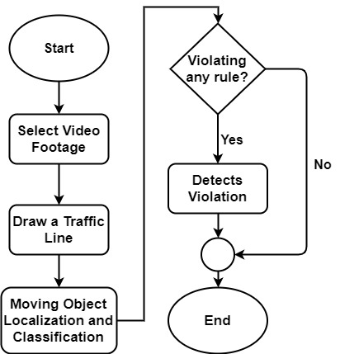
System Overview
4

Slide 5
Methodology
Vehicle Classification:
An object detection model YOLOv3 is used to classify the vehicles.
Features of the model:
Bounding Box Predictions
Class Prediction
Predictions across scales
Feature Extractor
5

Slide 6
Methodology (Cont.)
Bounding Box Predictions:
The network predicts 4 coordinates for each bounding box. YOLOv3 predicts an objectiveness score for each bounding box using logistic regression. 1 means complete overlap of bounding box prior over the ground truth object. It will predict only 1 bonding box prior for one ground truth object and any error in this would incur for both classification as well as detection loss.
6

Slide 7
Methodology (Cont.)
Class Prediction:
YOLOv3 uses independent logistic classifiers for each class instead of a regular softmax layer. This is done to make the classification multi-label classification. Each box predicts the classes the bounding box may contain using multilabel classification.
7

Slide 8
Methodology (Cont.)
Predictions across scales:
YOLOv3 predicts boxes at 3 different scales
Features are extracted from each scale by using feature pyramid networks
There are 3 bounding box priors per scale and thus total 9 bounding box priors
8

Slide 9
Methodology (Cont.)
Feature Extractor:
YOLOv3 uses a new network Darknet-53. Darknet-53 has 53 convolutional layers.
9

Slide 10
Methodology (Cont.)
Violaton Detection:
The vehicles are detected using YOLOv3 model. After detecting the vehicles, violation cases are checked. A traffic line is drawn over the road in the preview of the given video footage by the user. The line specifies that the traffic light is red. Violation happens if any vehicle crosses the traffic line in red state.
The detected objects have a green bounding box. If any vehicle passes the traffic light in red state, violation happens. After detecting violation, the bounding box around the vehicle becomes red.
10

Slide 11
Implementation
Computer Vision:
OpenCV is an open source computer vision and machine learning software library which is used in this project for image processing purpose. Tensorflow is used for implementing the vehicle classifier with darknet-53.
12

Slide 12
Implementation (Cont.)
Graphical User Interface:
Tkinter library has been used to build the GUI. The graphical user interface has all the options needed for the software.
13

Slide 13
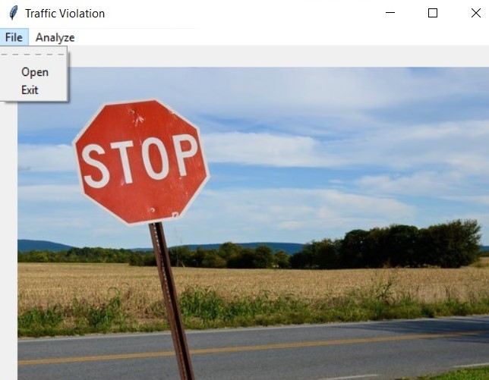
Implementation (Cont.)
Home Page
14

Slide 14
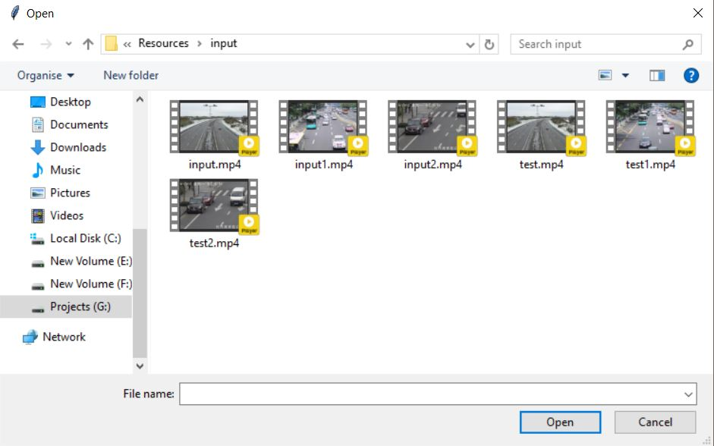
Implementation (Cont.)
Opening a video footage from storage
15

Slide 15
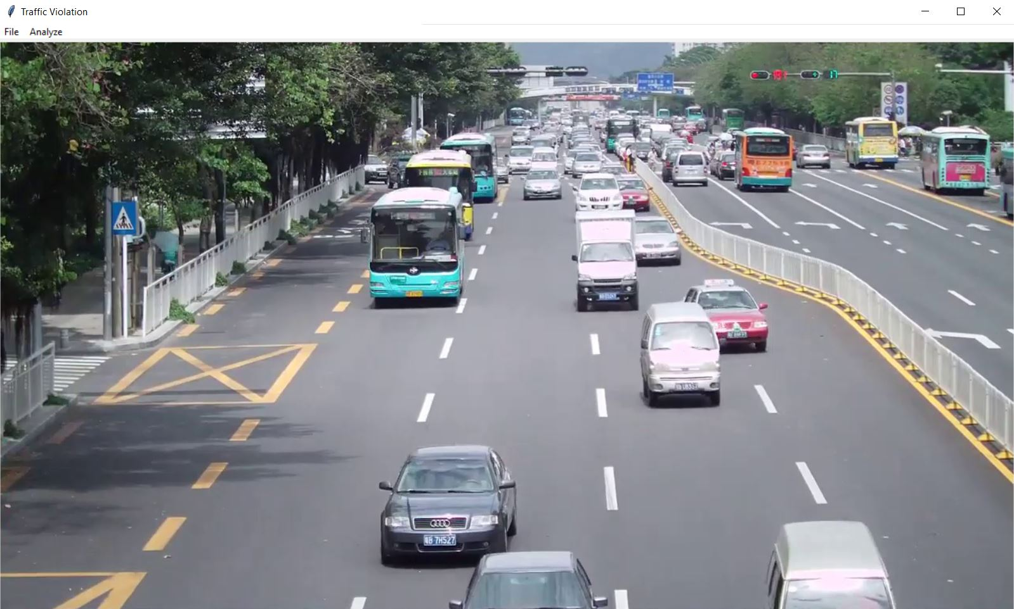
Implementation (Cont.)
Preview Loaded for specific video footage
16

Slide 16
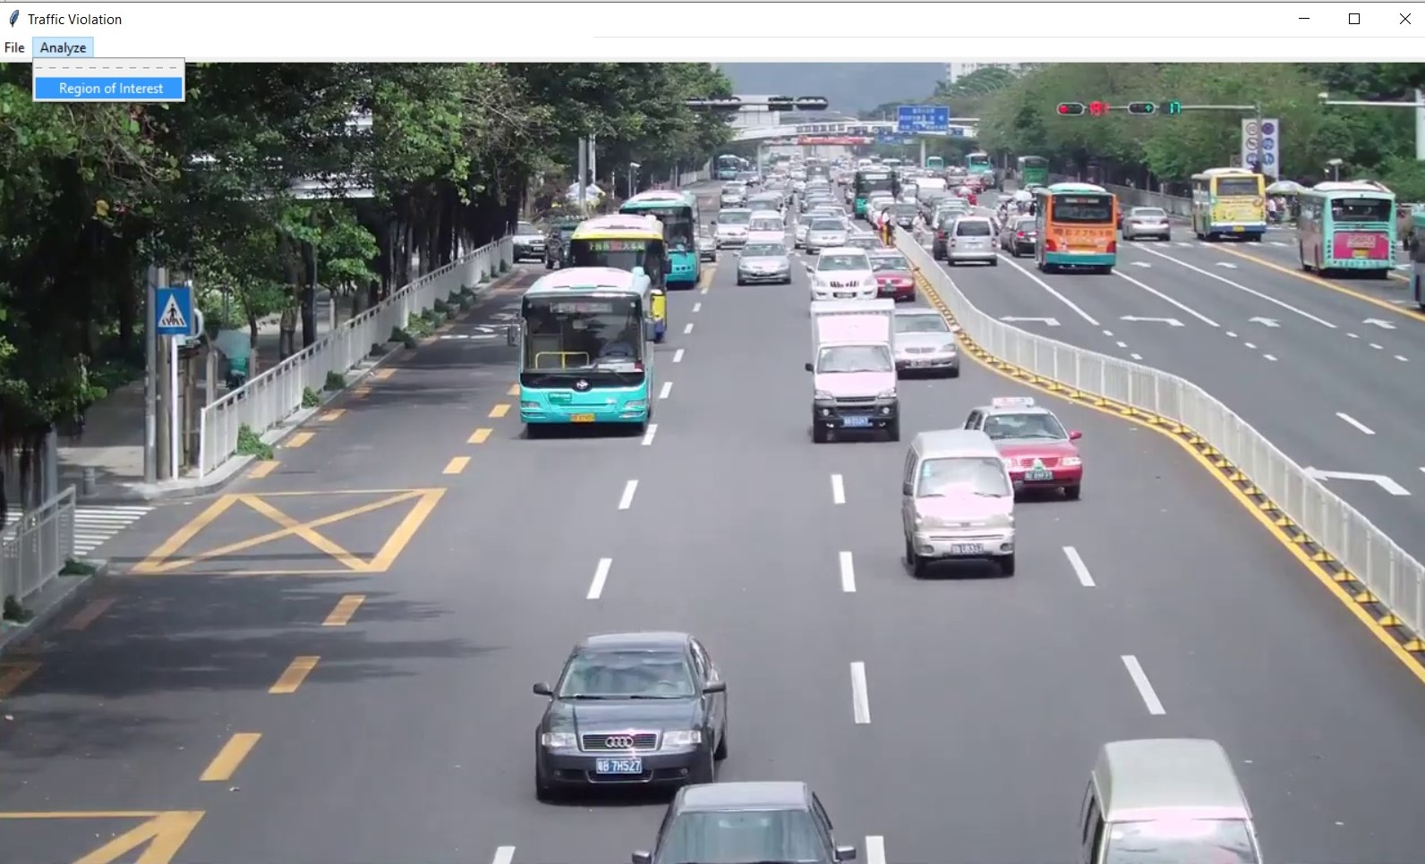
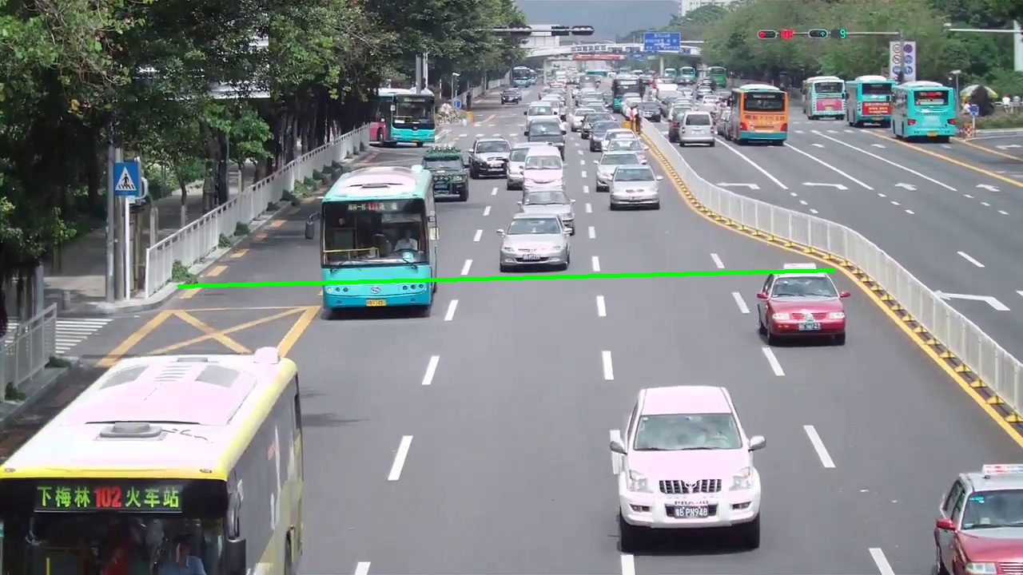
Implementation (Cont.)
Region of Interest
(Drawing Signal Line)
17

Slide 17
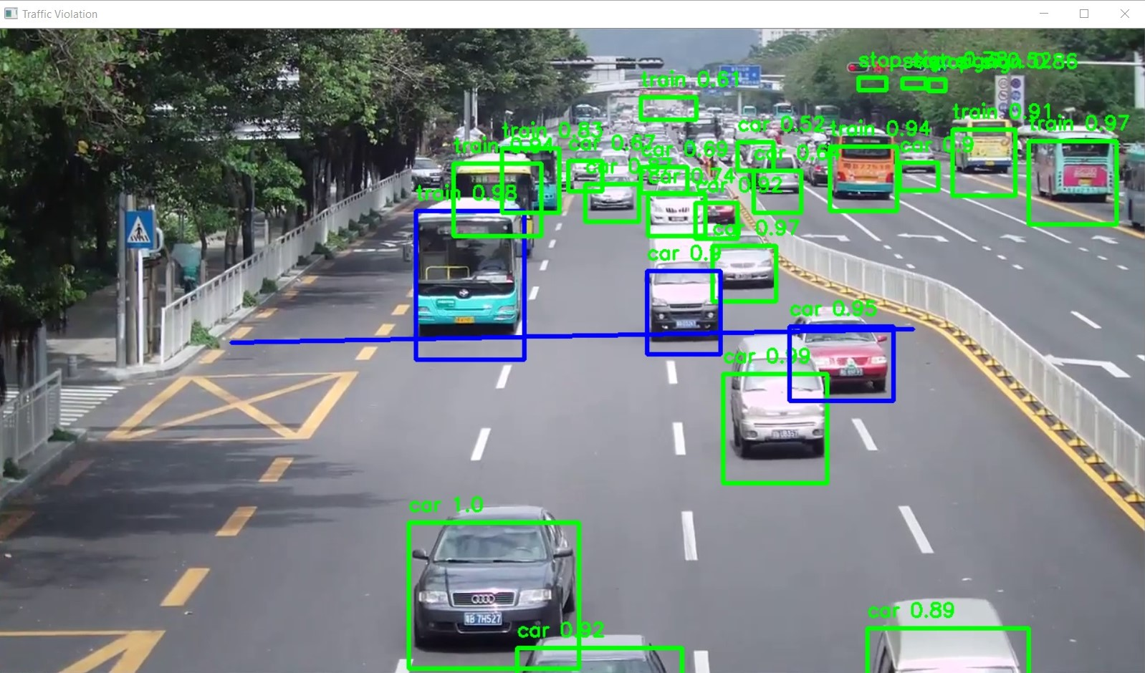
Implementation (Cont.)
Final Output
(on each frame)
18

Slide 18
THANK YOU
20

